Slide 1
BUS RESERVATION SYSTEM
PROGRAMMING FOR Program solving mini project
Name : Sreepradha k and kamya Gupta
Registration no. : RA2111003010315 AND RA2111003010320
Branch : Computer science and engineering (core)
Section : E1

Slide 2
ABOUT THE PROJECT
The Bus Reservation System is an application which is built without any graphics..
It is programmed using C language.
For the purpose of viewing the username, password, address, contact number and the ticket price.
Also to display it to the user in a fine way.

Slide 3
METHOD USED
#include<stdio.h>, #include<time.h>, #include<stdlib.h>, #include<string.h> and #include<ctype.h> are the header files used in this program.
#define function is used to allow the definition of macros within your source code ( for name, username, password, year, etc.).
SWITCH case is used in the code to give access to the user of five different options like Add Passenger, Delete Passenger Record, View Passenger Record, Update Credentials and Search Passenger Record.
IF ELSE and strncpy functions are used in our code.

Slide 4
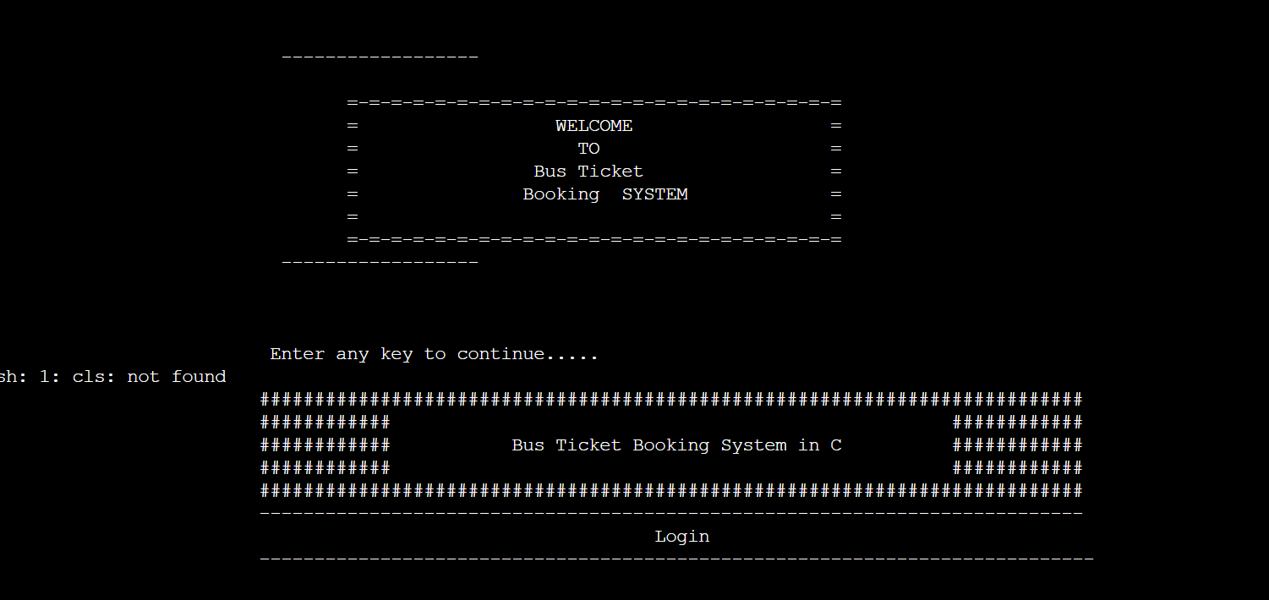
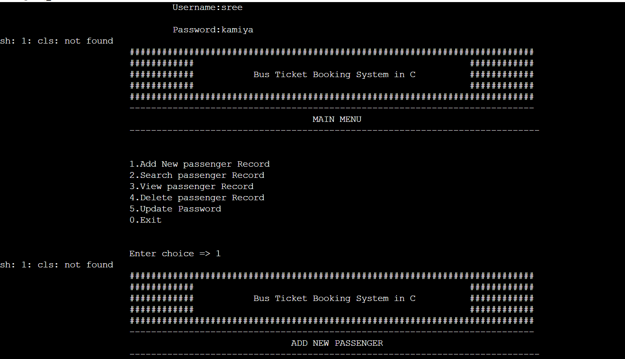
OUTPUT

Slide 5
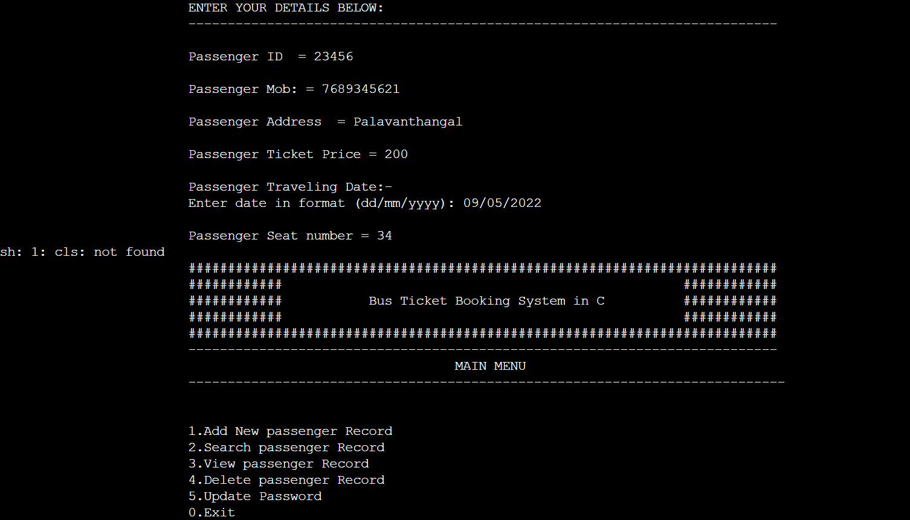
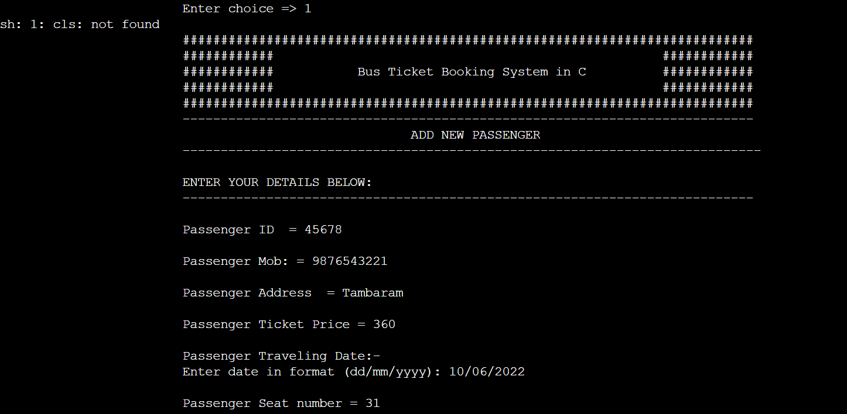

Slide 6
THANK YOU

